Slide 1
ITCS 3134
Yin Hang Kwok
E15 - Hough 1

Slide 2
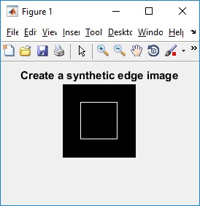
Create a synthetic edge image

Slide 3
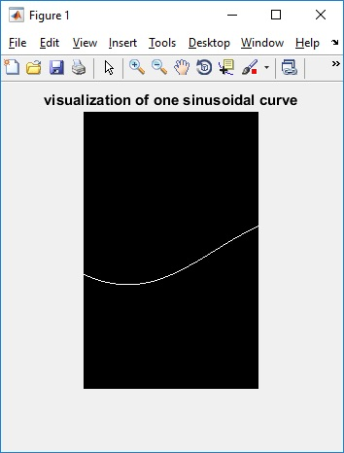
Visualization of accumulator array after populating the first edge pixel at [25,25]

Slide 4
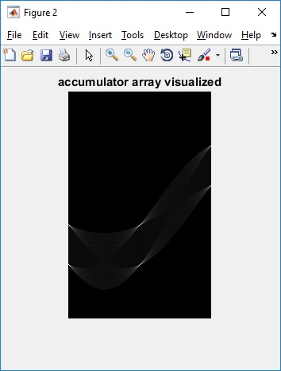
Visualization of accumulator array after populating all edge pixels

Slide 5
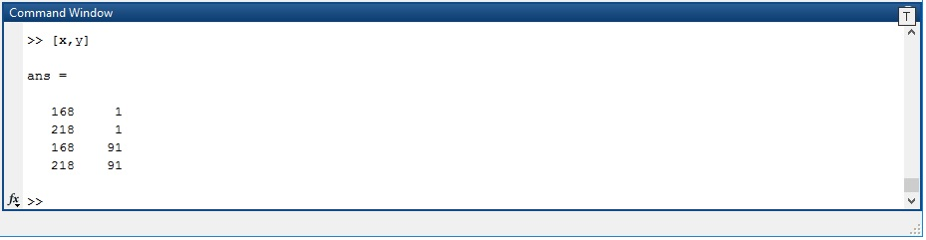
Locations (row, column) in accumulator array with the highest count

Slide 6
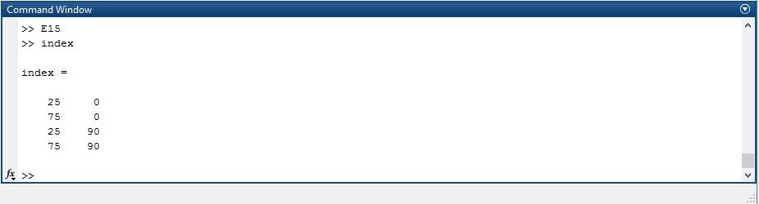
Conversion of those (row, column) to the equation of the line (rho, theta).

